Slide 1
Assisting Victims of Mortgage Fraud
National Crime Prevention Council 2015
www.ncpc.org

Slide 2
Introduction
The National Crime Prevention Council has prepared this course to inform and educate Victim Service Providers, attorneys, and other allied organizations about the many types of crimes, frauds and schemes associated with mortgage fraud today and how to best serve its victims.
The course is divided into three modules.
Part One provides an overview of how the economy and marketplace today present opportunities for new types of mortgage fraud.
Part Two provides background on the marketing and persuasion tactics used by fraudsters to commit mortgage fraud and on how homeowners can defend themselves against fraud.
Part Three offers instruction on reporting mortgage fraud and the steps victims can take to restore and remedy their situation.
Cover image from :http://www.yogakriya.org/php/pujananda/meanderings15.php

Slide 3
Objectives
To provide professionals who work with victims of mortgage fraud with
the knowledge to recognize current mortgage frauds.
the tools and resources to help those who are at risk or have fallen victim already.
Specifically, the goals of this course are to help Victim Service Providers to
recognize current mortgage scams and identify who is at risk
learn the steps that victims can take to recognize, and defend themselves against, mortgage fraud
understand why it is so important for victims to report mortgage fraud and the best way to help them do it
examine how to help victims by using best practices and by informing them of the programs and resources available
understand how to help victims to recover from mortgage fraud and to help them regain good financial standing.

Slide 4
In the beginning…

Slide 5
First wave of mortgage fraud: loan originations
Most Americans understand that the housing boom that peaked in 2005-2006 laid the groundwork for the financial crisis of 2008.
Interest rates were low, so the cost of debt and financing a home became more affordable.
Many individuals entered the housing market.
Housing prices rose.
Existing homeowners applied for second mortgages to take equity out of their homes and support their spending.
Housing prices continued to rise; more buyers entered the market.
With buyers feeling the pressure to qualify for a mortgage and profit from rapidly increasing home prices, the first wave of mortgage fraud occurred in loan originations.
Loan origination includes all the steps from taking a loan application through actual disbursal of funds.
Notes:
For nearly a decade before the housing bubble peaked in 2005-2006, a massive amount of money flowed into the United States from foreign investors. This liquidity pushed interest rates down so that the cost of debt and financing a home became more affordable. With interest rates low, many individuals entered the housing market. As the value of homes grew, many homeowners applied for second mortgages to take equity out of their homes and support their spending. With buyers feeling the pressure to qualify for a mortgage and profit from rapidly increasing home prices, the first wave of mortgage fraud occurred in loan originations.
Source: "President Bush's Address to the Nation". The New York Times. September 24, 2008.

Slide 6
First wave of mortgage fraud
Financial institutions sought to increase profits by adding features to their loans, including adjustable interest rates and prepayment penalties, which increased costs for borrowers.
To generate more income from fees, lenders directed many borrowers into higher cost loans even when they qualified for loans with more conventional terms.
As a result of these actions, many borrowers took out loans much larger than they could afford, assuming they would be able to sell or refinance their homes at a higher price later.
Countless borrowers also took out adjustable rate mortgages (ARMs), where initial interest rates were lower than those on fixed-rate loans.
With the flood of buyers seeking financing, and the pressure to generate fee income, many mortgage lenders approved “no doc” loans—waiving the documentation borrowers normally would need to support their ability to repay them.
Notes:
As home prices rose, some people feared being priced out of the market if they waited to buy, causing home values to rise further and more buyers to enter the market.
Many borrowers also took out adjustable rate mortgages (ARMs), where interest rates were lower than those on fixed-rate loans. With ARMs, after an initial period of fixed interest, rates can rise significantly, stretching borrower finances to the limit—or beyond their reach—with higher monthly payments.

Slide 7
First wave of mortgage fraud, cont’d
By 2004, the FBI warned that mortgage fraud was becoming so rampant that the resulting “epidemic” of crimes could trigger a massive financial crisis.
In 2005, the FBI reported that “mortgage fraud is one of the fastest growing white collar crimes in the United States.”
Notes:
In 2004 and 2005, there were dire warnings from the FBI about mortgage fraud.

Slide 8
Common loan origination scams
Inflated income or assets
Straw buyer
Identity theft
Inflated appraisal
Altered documents
Predatory lending
Multiple loans
Stated income loan
Air loans
Inflated deposits & soft second mortgages
Flipping
Money laundering
Notes:
Mortgage fraud is a material misstatement, misrepresentation, or omission in information relied on by an underwriter or lender to fund, purchase, or insure a loan. This type of fraud is usually defined as loan origination fraud. This slide illustrates a number of the ways in which loan origination fraud can be perpetrated.

Slide 9
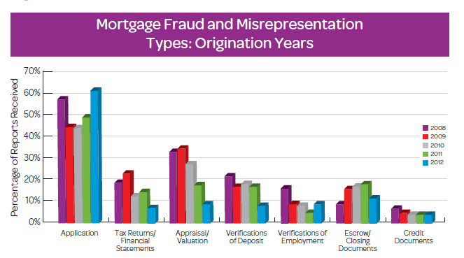
Loan origination fraud by type between 2008-2012
Notes:
For over two decades, major mortgage lenders, agencies, and insurers have been submitting information describing incidents of subscriber-verified fraud and material misrepresentation involving industry professionals to a database, known as MIDEX® (Mortgage Industry Data Exchange).
Subscribers use information from the MIDEX database as a risk management tool to protect against mortgage fraud perpetrated by industry professionals. The Mortgage Fraud Index, or MFI, is an indication of mortgage-related fraud and misrepresentation involving industry professionals found through MIDEX subscriber fraud investigations in various geographical areas within any particular year. It involves straightforward calculations.
Source: The LexisNexis® 15th Annual Mortgage Fraud Report, p. 10. www.mortgagefraudblog.com/wp-content/uploads/2013/09/15th-Annual-Mortgage-Fraud-Report-LexisNexis.pdf. Accessed 10-23-2014

Slide 10
Housing boom collapse
The financial rewards of rising house prices also led to a boom in new home construction.
By 2007, there were more houses on the market than people willing to buy them.
The inventory of available single-family homes, which had been expanding rapidly in a real estate construction boom that coincided with price increases, had grown to the point where downward pressure was now exerted on prices.
A long and slow correction began as real estate prices began to fall.
The housing market collapsed in 2007.
Notes:
The problem began when borrowers with adjustable rate mortgages who had planned to sell or refinance their homes before the adjustments kicked in were unable to refinance, prompting many mortgage holders to default as the adjustments began.
Source: "FBI warns of mortgage fraud 'epidemic'". CNN. February 6, 2004.
Source: Philyaw, Jason. "Underwater mortgages back above 11 million in 4Q". CoreLogic.

Slide 11
Housing boom collapse, cont’d
At the same time, the interest rates on many adjustable rate mortgages (ARMs) changed to the higher rates.
Borrowers with ARMs who had planned to sell their homes before the high interest rates kicked in found that, because of the dramatic drop in housing prices, they were “under water”, i.e., their mortgage balance was higher than the market price for their homes.
Other borrowers who had planned to refinance their homes before the adjustments kicked in were unable to refinance, again because the equity in their homes had disappeared.
Homeowners began to default on their mortgages when the adjustments began.
Default rates on subprime and ARMs began to climb.
Notes:
Default rates on subprime and adjustable-rate mortgages (ARMs) began to climb, setting the stage for a new wave of mortgage fraud. The housing boom collapsed in 2007. By the end of 2010, 11 million residential properties, or 23% of all U.S. homes, were in negative equity (what was owed on the mortgage was greater than the house could be sold for).
Source: "FBI warns of mortgage fraud 'epidemic'". CNN. February 6, 2004.
Source: Philyaw, Jason. "Underwater mortgages back above 11 million in 4Q". CoreLogic.

Slide 12
Foreclosure crisis
Foreclosure filings nationwide increased from 1.3 million in 2006 to 2.2 million in 2007, 3.2 million in 2008, and 4 million in 2009.
The financial crisis that began in 2008, rooted in the massive mortgage defaults that were occurring, compounded the problem.
Millions of people lost their jobs and could not afford to pay their mortgages, whether they were adjustable or fixed rate.
By the end of 2010, 11 million residential properties, or 23 percent of all U.S. homes, were under water—that is, they had negative equity.
The impact of a foreclosure can be devastating, including loss of home (often a family’s most significant financial asset), severe damage to a credit rating, and strains on emotional health.
Notes:
Source: www.preventloanscams.org/resources/issues/the-foreclosure-crisis
RealtyTrac

Slide 13
Foreclosure crisis opens door for new fraud
Today, the US housing market is still in distress, with ample opportunity for fraud.
This new wave of mortgage fraud is expanding beyond loan origination to new schemes.
Government agencies warn of an epidemic of loan modification and foreclosure-rescue scams.
There is good news. More information and resources are available to deal with mortgage scams than ever before.
Notes:
As the markets change, so do the scammers. They are constantly adapting and changing. When it became clear that loan origination was no longer a ‘pot of gold’ as earlier, the scammers moved on to new schemes within loan modification and foreclosure rescue.
Source: www.preventloanscams.org/resources/issues/the-foreclosure-crisis RealtyTrac

Slide 14
Top locations for mortgage fraud in the U.S. 2012
Top 10 states with loans under investigation | Top five metropolitan areas
1. Michigan | San Francisco (Oakland, Fremont) CA
2. Nevada
3. Arizona | Philadelphia (Camden, Wilmington) PA/ NJ/DE/MD
4. Delaware
5. Illinois | Los Angeles (Long Beach, Santa Ana) CA
6. New Jersey
7. California | New York (Northern New Jersey, Long Island) NY/ NJ/PA
8. Michigan
9. Georgia | Miami (Ft. Lauderdale, Pompano Beach) FL
10. New York
Notes:
Source: LexisNexis 15th Annual Mortgage Fraud Report. August 2013

Slide 15
Part Two: Protect and Respond
Assisting Victims of Mortgage Fraud

Slide 16
Part Two goals
The goals of Part Two, “Protect and Respond”, are to equip you with tools to help homeowners defend and protect themselves from fraud.
This section will help you to
recognize “red flag” tactics used by fraudsters to lure distressed homeowners
learn how scammers market their “services”
advise homeowners on how to protect themselves during the loan modification/foreclosure process.
Notes:
The goals of Part 2, “Protect and Respond” will help you, as Victim Service Providers, become more aware of mortgage fraud generally and how you can help victims. Specifically, it will help you to:
recognize the tactics used by fraudsters to lure distressed homeowners into fraudulent mortgage transactions.
learn how homeowners can guard themselves against falling victim to mortgage scammers by recognizing the ways in which they market their “services."
advise homeowners as to how they can protect themselves against scams
We discuss these steps during the loan modification and foreclosure processes. We will discuss in detail what each of these processes entails as we move through the course.

Slide 17
Introduction
Children’s stories are full of warnings. The spider lures a fly into its web. A gingerbread house looks good but harbors a wicked witch. Dorothy follows the yellow brick road.
Mortgage fraudsters use similarly appealing tactics to lure homeowners into their webs.
But we forget these timeless warnings as adults.
Once the homeowner is in the web, the scammer has a variety of scams to choose from, depending upon the profile of the victim.
We examine the scammers’ behavior during two phases of a scam process
Marketing
Transacting Business.
Notes:
Children’s stories are full of warnings. These stories are meant to help children recognize danger, the consequences of ignoring danger, and how to avoid the danger or get out of trouble once they’ve encountered it.
As adults, though, we forget those timeless warnings when faced with very real life issues—like losing our greatest investment.
While loan modification and foreclosure rescue fraud involve different processes, they share some of the same marketing tactics to attract distressed homeowners and draw them into their webs.
Once in the web, fraudsters press on to get the homeowner to sign. We examine the fraudsters’ behavior during two phases of a scam process
Marketing
Business transactions

Slide 18
Says the Spider to the Fly… Marketing Phase: How Fraudsters Lure Their Victims

Slide 19
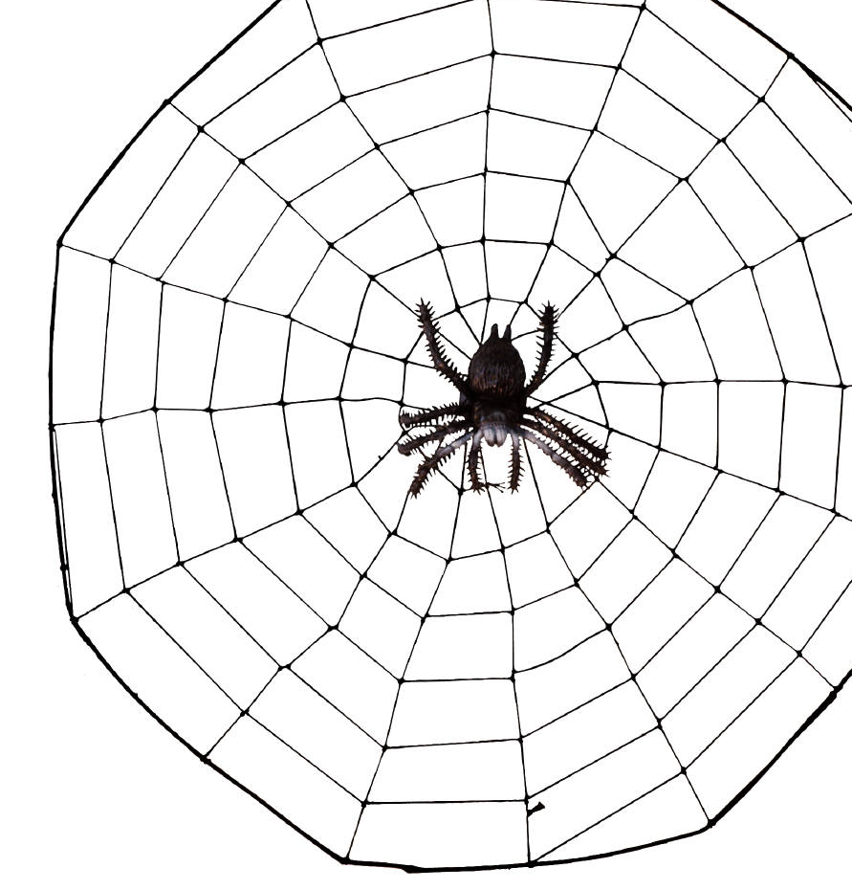
"Will you walk into my parlor?" said the spider to the fly;
"Tis the prettiest little parlor that ever you did spy.
The way into my parlor is up a winding stair,
And I have many pretty things to show when you are there."
"O no, no," said the little fly, "To ask me is in vain,
For who goes up your winding stair can ne'er come down again."
Poem by Mary Howitt
Notes:
The poem “The Spider and the Fly” was written by Mary Howitt in the early 1800s. The opening line is one of the most recognized and quoted first lines in all of English verse. The poem is described as a “cautionary tale against those who use flattery and charm to disguise their true evil intentions."
What’s interesting is that the thoughts expressed in this poem apply as much today as they did in 1829 when the poem was published. The thoughts are particularly applicable to mortgage fraud, where vulnerable people are desperate to find a way out of their dilemma.
Poem by Mary Howitt www.ocf.berkeley.edu/~aathavan/poems/The%20Spider%20and%20The%20Fly%20A%20Fable.htm, accessed on 9/1/2014.

Slide 20
Mortgage fraudsters use various tactics to find victims
At home | Telemarketers Letters/flyers Door-to-door
In the community | Church meetings Senior citizen programs Ethnic and cultural communities (affinity marketing) Support groups and seminars
On the internet
Advertising and roadside signs
Mortgage fraudsters | Pose as law firms Offer customer “testimonials” Are smooth-talking Provide little information about the process
Notes:
How do fraudsters find their victims? They are very resourceful. They find them at home by having telemarketers call, by sending letters by mail, even by knocking at the door.
Fraudsters find their victims in the community: at church meetings, senior citizens programs, ethnic and cultural communities, even support groups and seminars for those struggling financially.
And fraudsters also have unknowing victims come to them through websites and ads on the internet or through advertising or even signs on lamp posts.
Fraudsters even pose as law firms, or partner with a law firm, offering legal help that turns out to be bogus.
And fraudsters offer “testimonials” from other customers because they know that word of mouth advertising is so powerful.
Fraudsters are smooth-talking and know what to say to get the victim’s interest. But the fraudster provides very little information about how the process actually works.

Slide 21
Examples of common marketing tactics
and their “red flags”
Notes:
The following slides show examples of marketing tactics that have been used to defraud homeowners.

Slide 22
Telemarketing
Scammers use telemarketing to offer mortgage modification services to distressed homeowners by
first soliciting distressed homeowners via mail or email, claiming, for example, “mortgage modification plan approved”
having the homeowner call the scammer’s listed number.
“Red Flags”
Sales staff offer
legal counsel to work with bank
underwriters to guarantee new rate, lower payment
free services.
Scammer charges upfront fees.
Scammer performs none of the promised services.
Notes:
A fraudulent loan modification company that offered mortgage modification services also had sales and telemarketing staff. The scammers reportedly
purchased thousands of "leads”, i.e., names, addresses and other contact information, for homeowners who were behind on mortgage payments
solicited homeowners via email, telling them that the Home Affordable Modification Program (HAMP), a federal government program, was already reviewing their cases and their respective lenders had already approved a modified mortgage payment plan.
had their sales staff answer telephone calls from the recipients of these fraudulent solicitations, falsely promising:
legal counsel to complete the HAMP application and negotiate with banks on the homeowner's behalf for a lower mortgage payment
underwriters who would guarantee a new rate and lower mortgage payment
free mortgage modification services, with any upfront fees going to the homeowner's lender.
The false mortgage company received payment of thousands of dollars in upfront fees by homeowners who believed their money was going to their respective lenders. The money was in fact going to the telemarketing firm, which never delivered on any of its promises.

Slide 23
Official-looking mailers
Mailers look like they come from a government agency.
“Red Flags”
Mailers that contain phrases like the following
“Official Business”
“Important Notice From Your Mortgage Company”
“Open Immediately—Important Financial Information Enclosed”
“Government Economic Stimulus Act”
“Please Do Not Discard—Account Information Enclosed”.
Notes:
It is getting more and more difficult to tell junk mail from legitimate mail these days. Mailers that look like they come from a government agency, or have information about the homeowner’s mortgage, likely come from a scammer.
This slide illustrates some of the common phrases that are used by scammers on the outside and inside of the envelopes to get the homeowner to read them. These phrases should all be considered “red flags.” Legitimate businesses tend to stay away from sensational phrases such as these.
www.getoutofdebt.org/24531/premier-debt-resolvers-deceptive-mailer-government-economic-stimulus-act

Slide 24
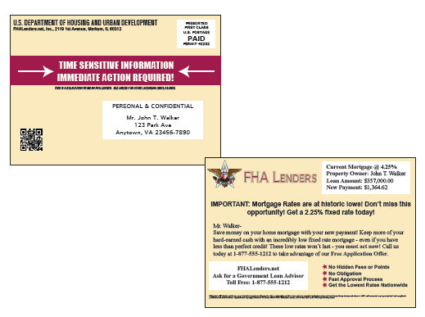
Official-looking mailers, cont’d
In this example, the mailer
appears to come from the US government
has specific information about the addressee’s mortgage
offers low rate
urges immediate action.
Notes:
Mailers are becoming very sophisticated and convincing in appearance. And don’t think scammers won’t go to a lot of expense to lure their victims. They will. They plan to be making a lot of money from their victims, so they spare no expense in luring them. For scammers, it’s a business and their profits far exceed their expenses.

Slide 25
Advertising
Ads appear on the internet, on television, in the paper, by fax and by mail.
“Red Flag” buzz words
Low “fixed” rate
“Historically low rates”
Very low payments
VA programs for Veterans
Special appeals to senior citizens
.
Notes:
This slide illustrates some of the buzz words that should trigger follow-up questions by the homeowner. Ads appear on the Internet, television, in the paper, by fax and by mail. Some look like they’re from the victim’s mortgage company or a government agency. Although they are tempting, they are flawed; they don’t disclose the true terms of the deal as the law requires.
www.dsnews.com/news/08-07-2014/three-charged-fraud-massive-mortgage-modification-scam
www.consumer.ftc.gov/articles/0087-deceptive-mortgage-ads

Slide 26
Examples of advertising
These ads use all of the buzz words AND claim credibility by using the President’s photo (associating with government programs) or media endorsement.
Notes:
www.ftc.gov/news-events/press-releases/2012/03/ftc-legal-action-halts-alleged-mortgage-relief-scammers-who-lured

Slide 27
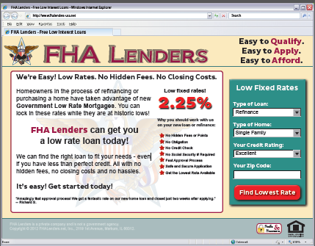
Fraudulent websites
Scammers often have professional-looking websites that are difficult to distinguish from legitimate sites.
“Red Flags”
They make outrageous claims.
“Stop foreclosure with just one call”
“Will $ buy $ your house”
“Need instant debt relief and CASH?”
“We Buy Ugly Houses”
Contact forms are provided on each page.
Logos are copied from credible institutions such as
television stations
FHA Lenders.
Notes:
Websites, and the information they contain, are part of everyone’s lives. Most of us couldn’t live without the internet. So, when it comes to mortgage fraud, how can the homeowner tell the legitimate ones from the fraudulent ones?
The fraudulent ones make outrageous claims. Most people would be skeptical about a website advertising a pill that could make them lose 20 pounds in a week. But those same people are hooked with outrageous claims, such as, “stopping foreclosure with one phone call.”
www.ftc.gov/sites/default/files/attachments/press-releases/ftc-warns-mortgage-advertisers-their-ads-may-violate-federal-law/121119mortgagead_mockads.pdf

Slide 28
Internet chat rooms
Desperate homeowners visit online chat rooms seeking help.
“Red Flags”
Scammers—in the guise of investors
scan sites
engage in conversation with distressed homeowner
offer help
then scam homeowner.
At right, a homeowner seeks a private investor to buy, then lease back, their house.
This is not how legitimate lenders operate.
Notes:
Scammers trawl internet chat rooms looking for desperate homeowners who are seeking help with their high mortgage payments or impending foreclosures. In the case illustrated on this slide, a homeowner is seeking a private investor to buy his house and then lease it back. Two “investors” have expressed interest and provided their contact information.

Slide 29
Marketing to seniors
Trusted celebrity spokespeople pitch aging baby boomers/seniors to take out reverse mortgages.
“Red Flags”
Ads make misleading statements
“Live a better life now.”
“No more mortgage payments.”
“Own your home.”
“You won’t lose your home.”
“Tax-free cash.”
Disclaimers are in small print.
There is no mention that insurance, taxes, etc. must be paid.
The risk of reverse mortgages to seniors, e.g., eligibility for Medicaid or Supplemental Security Income (SSI), is downplayed.
Notes:
Lenders use trusted celebrities as spokespersons to encourage aging baby boomers/seniors to take out reverse mortgages. The ads make misleading statements like “live a better life now”, “no more mortgage payments”, and “own your home,” downplaying the risk of reverse mortgages to seniors. Reverse mortgages could impact eligibility for Medicaid or Supplemental Security Income (SSI). Disclaimers are in small, almost illegible font that only the keenest eyes (which seniors don’t typically have) can spot.
There’s no mention that homeowners must continue to pay insurance, taxes, maintain the property, and comply with loan terms. Testimonials from “satisfied customers” claim, “It doesn’t cost anything. You won’t lose anything.”
www.nytimes.com/2012/03/08/business/retirementspecial/new-career-for-aging-celebrities-tv-pitchman.html?pagewanted=all

Slide 30
Marketing to seniors, cont’d
Print and banner ads mislead by ignoring risks.
Notes:
Print ads tend to feature attractive, healthy, and happy seniors reaping the benefits of their reverse mortgages. Just as most people would question the “before” and “after” claims of weight loss advertising, they need to look at these ads with a skeptical eye as well.

Slide 31
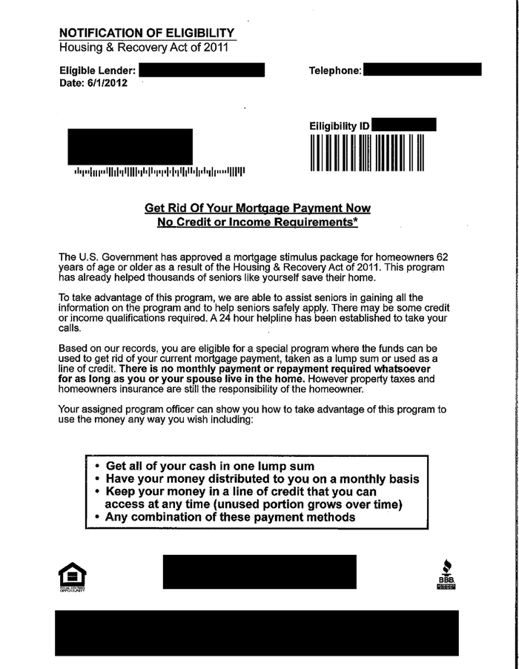
Marketing to seniors, cont’d
This piece, mailed to persons over 62, makes false claims and misleading statements about government programs.
Notes:
Seniors often fall for advertising that has the look or promise of a government program—their feeling is, if a program is sponsored by the government, then it can’t possibly be a scam.

Slide 32
“Affinity” marketing
Scammer builds trust based on a common ethnicity or religion.
It is natural to trust people who share a common language, culture, or physical appearance.
Often the scammer attends the same church, knows same people.
The scammer can be a stranger, hundreds of miles away, in the same community where the target feels safe.
Affinity fraud is not really a type of fraud. It’s a way to market fraud. Think of it more in terms of friends and family fraud.
-- Keith Woodwell, Utah Division of Securities Director
Notes:
Affinity marketing is when the scammer shows an “affinity” for, that is, a connection to, the group he has targeted for his scam. For example, he may be of the same race, ethnicity, religion or in a similar life situation.
As a result, the group feels more comfortable with him. People who have immigrated to the United States and are not native Americans are more likely to trust people they can relate to on basis of a shared language, culture, or physical appearance. In some cases, the scammer may even attend the same church and have common acquaintances with the potential victim.
In Queens, N.Y. in 2012, a self-made real estate magnate of Guyanese descent bilked hundreds of Guyanese immigrants in a $50 million mortgage fraud. The scammer appeared more trustworthy to the Guyanese because he was one of them.
Queens Broker Is Accused of Bringing Immigrants’ Ruin, NYT, 1.8.2012
www.reviewjournal.com/john-l-smith/thieves-temple

Slide 33
Example of “affinity marketing”
The telemarketer speaks Spanish and targets Spanish-speaking homeowners.
“Red Flags”
The telemarketer
empathizes with the homeowner about the tough economy
claims to provide information about federal mortgage assistance programs
falsely claims affiliation with consumers’ lender or government
mentions President Obama or the (federal) Making Home Affordable Program.
Notes:
Speaking in Spanish and targeting homeowners who have fallen behind in their payments or were facing foreclosure, telemarketers empathized about the tough economy and claimed to provide information about federal mortgage assistance programs, according to a complaint.
In lengthy sales calls, the telemarketers falsely claimed to be affiliated with, or approved by, the consumers’ lenders or the federal government. According to complaints, they consistently mentioned either President Obama or the federal Making Home Affordable Program by name.
www.ftc.gov/news-events/press-releases/2013/01/defendants-dominican-mortgage-assistance-scam-allegedly-defrauded

Slide 34
Fraudulent legal assistance
Is it genuine legal assistance or a foreclosure scam?
Red Flags
The lawyer wants homeowner to pay first before modification.
The lawyer guarantees that homeowner will get loan modification.
The lawyer calls or e-mails homeowner in an effort to be hired.
Law firms are banned from requesting or receiving payment from clients until they have signed a mortgage modification agreement with the lender.
Notes:
In 2014, the Consumer Financial Protection Board charged two law firms offering legal services with taking in over $19.2 million in fees from more than 10,000 distressed homeowners nationwide. Most, if not all, of that money came from illegal advance fees for so-called loan modification services.
www.files.consumerfinance.gov/f/201407_cfpb_handout_real-legal-help-or-foreclosure-scam.pdf

Slide 35
What victims need to know
Be suspicious of
official-looking seals or logos
promises of amazingly low rates
promises that a reverse mortgage will allow victims to stay in their home payment-free
announcements of “pre-approval” and cash/credit.
Legitimate foreclosure consultants
don't seek victims out—homeowner must go to them
don’t make outrageous promises on internet websites
don’t trawl chat rooms looking for victims.
Notes:
There are certain things that legitimate foreclosure consultants will never do. Just as a bank will never solicit personal banking information over the internet, legitimate foreclosure consultants will never seek those in need, make outrageous promises on internet websites, or search out victims via chat rooms.

Slide 36
"I've got them now; they shan't escape me." Transaction Phase: How to Recognize Fraudulent Business Conduct

Slide 37
“The old woman had appeared to be most friendly, but she was really an old witch who had only built the little gingerbread house in order to lure them in.
“When Hansel and Gretel fell into her hands she laughed maliciously, and said jeeringly, "I've got them now; they shall not escape me."
Notes:
Tales of victims being lured with false promises are as old as time. Most of us want to believe that people are really trying to help us. But when it comes to mortgage fraud, the only thing on the scammers’ minds is gain for themselves at any cost to the victim.
Quote source: The story of Hansel and Gretel, Brothers Grimm, www.eastoftheweb.com/short-stories/UBooks/HanGre.shtml

Slide 38
Recognizing fraudster business tactics
If a homeowner has contacted a questionable mortgage loan modifier/broker/ lawyer/investor, there are “red flags” that serve as warnings and help the homeowner to avoid becoming a victim.
Recognizing these red flags will help victims respond by reporting the fraudster and seeking help from an approved housing counseling agency.
Fraudsters are | smooth talkers
 | manipulative
 | outright liars
 | pushy
 | confusing
Notes:
There are many characteristics of fraudsters that homeowners should be aware of. The majority of homeowners are emotionally tied to their homes so they may overlook certain traits in the fraudster’s personality (manipulative, pushy, confusing) that they would not overlook in a sales situation that was not so emotionally charged, such as buying a car or a vacuum cleaner, etc.

Slide 39
Examples of fraudster business tactics
and their “red flags”
Notes:
The following slides show examples of tactics used by fraudsters to lead the homeowner astray during a loan modification or foreclosure rescue process.

Slide 40
The fraudster is a smooth talker
Fraudsters depend on winning the homeowner’s trust.
“Red Flags”
Fraudsters
are smooth talkers and make assurances to comfort homeowner
make promises while taking advantage of the homeowner’s vulnerability
offer to buy the victim’s house and rent it back
isolate victims by instructing them not to seek outside help and to cease contact with their lending institution, other agencies, or law firms
make the homeowner feel naïve and ignorant by offering complicated explanations.
Notes:
Once the fraudster has successfully identified a target and approached, the fraudster employs a broad range of manipulative tactics to ensure that the distressed homeowner does not get away—before they have been scammed, that is!
The fraudster will make promises while assuring the homeowner that he has come to help.
The fraudster will isolate his victim by telling them that there is no need to seek help from anyone else because the situation is under control. The fraudster instructs his victim to cease contact with the lending institution and with any other agencies or law firms.
The fraudster will further isolate the victim by making them feel naïve and ignorant. The scammer achieves this by offering complicated explanations and burying the victim in mounds of paperwork.
Even as the victim may start to feel uncomfortable or suspicious, they will be reluctant to reach out for help, feeling embarrassed for having fallen for a scam.

Slide 41
The fraudster is manipulative
Fast-talking fraudsters lead victims through a confusing maze of information and promises to achieve their desired outcome.
“Red Flags”
The scammer
guarantees he will save the victim’s home from foreclosure
promises to return any fees paid if not successful
assures that the process will be quick and easy
convinces the homeowner to rely on him
asks the victim to make payments to him and not to the mortgage lender.
Notes:
The scammer will make all kinds of guarantees to keep the homeowner dependent upon him—but those guarantees will never be kept.

Slide 42
The fraudster uses similarity to the victim
With “affinity fraud,” scammers build relationships with distraught homeowners through a shared ethnic background.
“Red Flags”
The fraudster using ethnic affinity
speaks the same language
demonstrates an understanding of culture and customs
conducts business transactions with clients in their native language
presents customers with English-language documents in which the terms have been altered.
Notes:
Fraudsters use “affinity” of religion, ethnicity, situation (e.g., grieving), having children in college, etc. In one example, a mortgage broker targeted Hispanic consumers for mortgage refinancing. He conducted his business transactions with clients almost exclusively in Spanish and promised them certain monthly payments, interest rates, annual percentage rates, finance charges, terms of repayment, and cash-back payments from their home equity.
When it was time for the closing, he presented his customers with documents written entirely in English that provided less favorable terms that those they had been verbally promised.
www.ftc.gov/news-events/press-releases/2006/01/ftc-continues-campaign-stop-fraud-spanish-language
www.ftc.gov/news-events/press-releases/2013/01/defendants-dominican-mortgage-assistance-scam-allegedly-defrauded

Slide 43
The fraudster requires payment up front
One way mortgage scammers make money is through payments the homeowner makes for their “services.”
“Red Flags”
The scammer
charges the victim an upfront fee
asks the victim to make payments to him and not the mortgage lender
is hard to reach once the upfront fees have been paid and the paperwork signed
offers to buy the victim’s house and rent it back.
Notes:
If this one key component could be recognized upfront as a red flag of mortgage fraud, most mortgage fraud scammers would fail and most frauds would never take place!
Legitimate mortgage advisers will never ask for an upfront fee!

Slide 44
The fraudster buries victim in paperwork
A common tactic in mortgage fraud is to present the homeowner with stacks of papers.
“Red Flags”
The scammer
assures homeowner that papers are “standard contract”
does not provide any upfront documentation, such as a HUD-1 form, detailing a complete list of incoming and outgoing funds
denies the victim sufficient time to carefully review the contract
intimidates the victim by hurrying the contract review process.
Notes:
Most people are subject to the “fatigue factor” when it comes to paperwork—in both fraudulent and legitimate mortgage situations. However, fraudsters in particular rely on the “fatigue factor” because it means that the victims are less likely to catch problems with the paperwork or to notice what is buried in other documents. In addition, in legitimate mortgage situations, a HUD-1 form is provided. This is a form used by a settlement or closing agent itemizing all charges imposed on a borrower and seller in a real estate transaction. This form gives a picture of the closing transaction, and provides each party with a complete list of incoming and outgoing funds. Scammers will not provide a HUD-1 form.

Slide 45
What victims need to know
Legitimate loan modification or foreclosure consultants
don't ask for an upfront fee*
don’t ask the homeowner to deal exclusively with them
don’t promise process will be quick and easy—it is not!
don’t guarantee to stop foreclosure or modify a loan
don’t charge to help a homeowner qualify for government programs
don’t pressure a homeowner to sign a document before they have a chance to read and understand it
don’t ask for mortgage payments.
Notes:
A scammer will ask a homeowner to do all the things that a legitimate loan modification consultant will never ask the homeowner to do.
*It is illegal for a company/individual to charge fees in advance for loan modification or foreclosure services, according to the Federal Trade Commission (FTC) Mortgage Assistance Relief Service (MARS) Rule.

Slide 46
For More Information
National Crime Prevention Council
1201 Connecticut Avenue, NW
Suite 200
Washington, DC 20036-2636
202-466-6272
www.ncpc.org
© 2015 National Crime Prevention Council, Inc. www.ncpc.org
Notes:
This project was supported by Grant No. 2011-VF-GX-K021 awarded by Office for Victims of Crime. The Office for Victims of Crime is a component of the Office of Justice Programs, which also includes the Bureau of Justice Statistics, the National Institute of Justice, the Office of Juvenile Justice and Delinquency Prevention, the SMART Office, and the Bureau of Justice Assistance. Points of view or opinions in this document are those of the author and do not represent the official position or policies of the United States Department of Justice.

